Slide 1

Network Defence Mechanism
And Cybersecurity Awareness for
UK Buisiness

Slide 2

Summmary
Target Audience
Security Mechanism tool
Encouraging Acceptance of Security Measures
Compliance Rules
Awaraness of compliance rules
Adhering of compliance rules
Importance of security measures
Common cybersecurity threats

Slide 3


Who are we targeting?
• Our target audience for this presentation is the employees of a UK-based financial institution with a workforce of over 1000 individuals.
• The reason for selecting this target audience is the high sensitivity of financial data, which makes it a prime target for cybercriminals.
• Their capacity and business requirement includes processing and handling large amounts of confidential financial data daily.

Slide 4

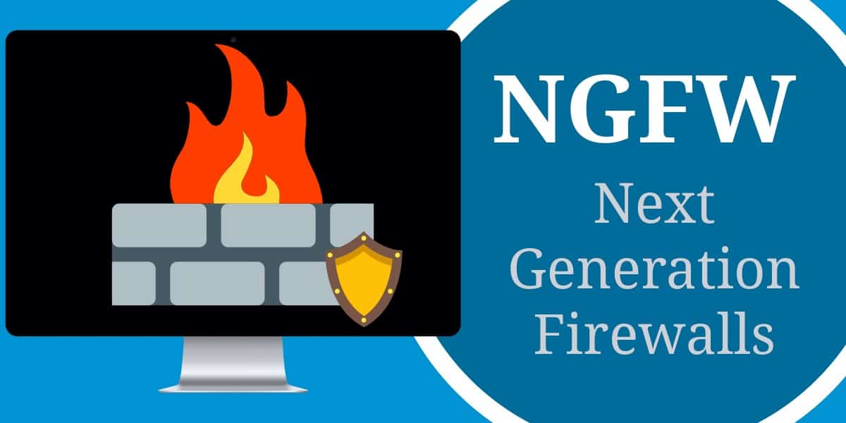
Network Defense Mechanism Tool
• The network defense mechanism tool we have chosen is a Next-Generation Firewall (NGFW).
• NGFW offers advanced features like Intrusion Detection and Prevention Systems (IDPS), deep packet inspection, and application-level inspection to improve the overall security posture of the network.

Slide 5


Encouraging Acceptance of Security Measures
• It's crucial to make sure that end-users and staff accept the new
tools to improve overall network security.
• The approach we propose is to provide extensive training to
staff and end-users on the importance of the NGFW and how it works.
• We can also provide simulation exercises where staff can learn
by implementing the new tool in a
simulated environment.

Slide 6


Governance and Compliance Rules
• The UK's Financial Conduct Authority (FCA) governs the regulations for financial institutions,
which include data protection and privacy regulations such as GDPR and the Data Protection Act 2018.
• The targeted audience must adhere to these regulations while operating in the UK.
• The consequences of non-compliance can result in fines, loss of reputation, and legal action.

Slide 7


Raising Awareness of Compliance Rules
• Raising awareness of compliance rules is crucial to ensure staff and end-users adhere to the regulations.
• We propose providing regular training and conducting compliance assessments to ensure they are aware of the latest regulations.
• Providing real-world examples and case studies can help staff and end-users understand the importance of compliance.

Slide 8


Implementing Compliance Rules
• Adhering to compliance rules involves implementing technical controls, policies, and procedures that are in line with the regulations.
• We propose implementing a formal data protection policy that outlines procedures and guidelines for handling and processing sensitive financial data.
• This policy should also cover the use of the NGFW to ensure compliance with data protection and privacy regulations.

Slide 9


Importance of Security Measures
• It's essential to understand the importance of security measures to protect sensitive financial data.
• The security triad (confidentiality, integrity, and availability) should be considered while implementing security measures.
• NGFW is an essential tool in improving the overall security posture of the network and ensuring the confidentiality, integrity, and availability of sensitive financial data.
and firewalls.

Slide 10


Threats to Sensitive Financial Data
• It's crucial to understand the common cybersecurity threats that can compromise sensitive financial data.
• Some of the most common threats include phishing attacks, malware, ransomware, and social engineering attacks.
• Employees must be trained to recognize and report these threats to prevent any damage to the network and data.
• Provide some examples and statistics to illustrate the impact of these threats on financial institutions, such as data breaches, financial loss, and reputational damage.
• Highlight some best practices and recommendations to prevent these threats, such as implementing strong passwords, two-factor authentication, regular updates and patches, and using security software like antivirus and firewalls.

Slide 11


Key Takeaways
• In conclusion, we have discussed the importance of implementing specific security measures and tools to protect sensitive financial data.
• We have identified NGFW as an essential tool in improving the overall security posture of the network.
• We have provided a valid approach for getting end-users and staff to accept the new tools proposed.
• Finally, we have highlighted the governance and compliance rules that the targeted audience must adhere to while operating in the UK.

